Slide 1
Data science : A practical approach

Slide 2
Day 1
Basic Introduction to Data science

Slide 3
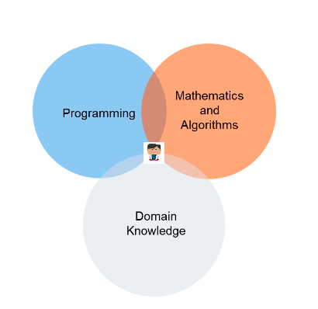
Data science
Data science is the field of study that combines domain expertise, programming skills, and knowledge of mathematics and statistics to extract meaningful insights from data.

Slide 4
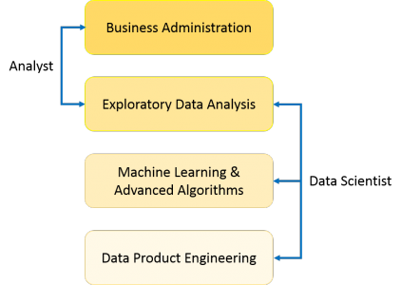
A typical flow for a data science problem

Slide 5
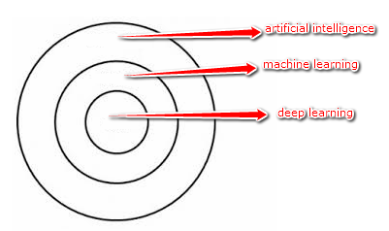
Buzzword explained
AI : AI is an umbrella discipline that covers everything related to making machines smarter
ML : The intention of ML is to enable machines to learn by themselves using the provided data and make accurate predictions.ML is a subset of artificial intelligence; in fact, it’s simply a technique for realizing AI.
DL: Deep learning is a subset of ML; in fact, it’s simply a technique for realizing machine learning.DL algorithms are roughly inspired by the information processing patterns found in the human brain.

Slide 6
Preliminary
Statistics is used to process complex problems in the real world so that Data Scientists and Analysts can look for meaningful trends and changes in Data. In simple words, Statistics can be used to derive meaningful insights from data by performing mathematical computations on it.
Linear algebra is the branch of mathematics concerning linear equations such as: linear maps such as: and their representations in vector spaces and through matrices. Linear algebra is central to almost all areas of mathematics.
In math, a graph can be defined as a pictorial representation or a diagram that represents data or values in an organized manner. The points on the graph often represent the relationship between two or more things.

Slide 7
Statistics 101
Arithmetic Mean in the most common and easily understood measure of central tendency. We can define mean as the value obtained by dividing the sum of measurements with the number of measurements contained in the data set
Arithmetic Median is a positional average and refers to the middle value in a distribution. It divides the series into two halves by first arranging the items in ascending or descending order of magnitude and then locating the middle value
Arithmetic Mode refers to the most frequently occurring value in the data set. In other words, modal value has the highest frequency associated with it.
The Arithmetic Range of a set of data is the difference between the highest and lowest values in the set.

Slide 8
Statistics 101
Average Deviation it is defined as the sum of the deviations(ignoring signs) from an average divided by the number of items in a distribution The average can be mean, median or mode.
A variance is defined as the average of Squared differences from mean value.
δ=∑(M−ni)^2/n
Standard deviation is the square root of the average of squared deviations of the items from their mean.
σ
Root Mean Square, RMS is defined as the square root of mean square where mean square is the arithmetic mean of the squares of numbers.

Slide 9
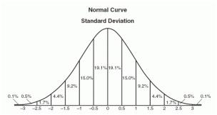
Statistics 101
A normal distribution is an arrangement of a data set in which most values cluster in the middle of the range and the rest taper off symmetrically toward either extreme. Height is one simple example of something that follows a normal distribution pattern: Most people are of average height the numbers of people that are taller and shorter than average are fairly equal and a very small (and still roughly equivalent) number of people are either extremely tall or extremely short. Here's an example of a normal distribution curve:

Slide 10
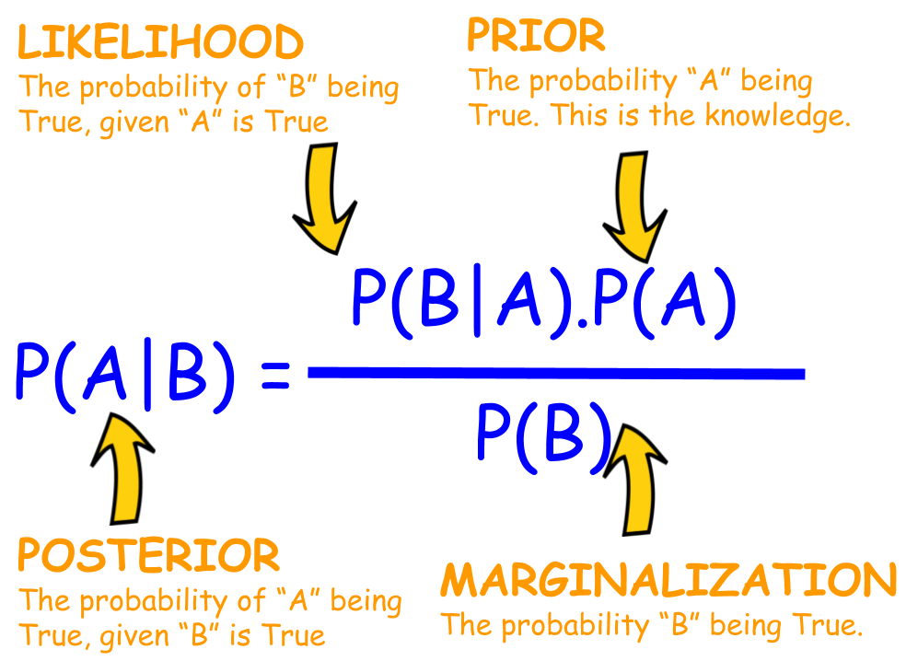
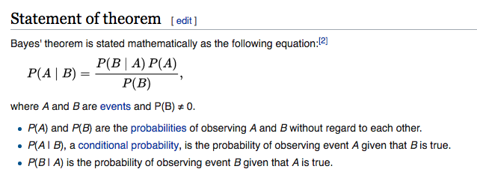
Statistics 101
In probability theory, a probability density function (PDF), or density of a continuous random variable, is a function that describes the relative likelihood for this random variable to take on a given value.
P(a≤X≤b)=∫baf(x)dx

Slide 11
Statistics 101
A qualitative variable, also called a categorical variable, is a variable that isn’t numerical. It describes data that fits into categories. For example:
Eye colors (variables include: blue, green, brown, hazel).
States (variables include: Florida, New Jersey, Washington).
Dog breeds (variables include: Alaskan Malamute, German Shepherd, Siberian Husky, Shih tzu).
Quantitative Variable | Qualitative Variables
Fractions | Cat breeds
Decimals | Cities
Odd Numbers | Fast Food Chains
Whole Numbers | College Major
Irrational Numbers | Fraternities
Ordered pairs (x,y) | Hair Color
Negative Numbers | Computer Brands

Slide 12
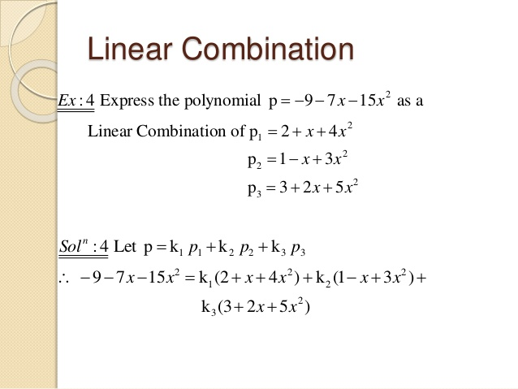
Linear Algebra 101

Slide 13
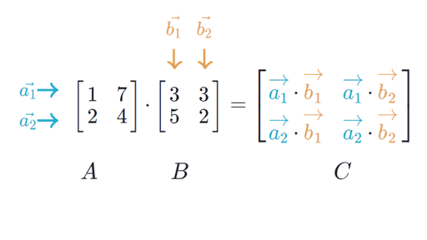
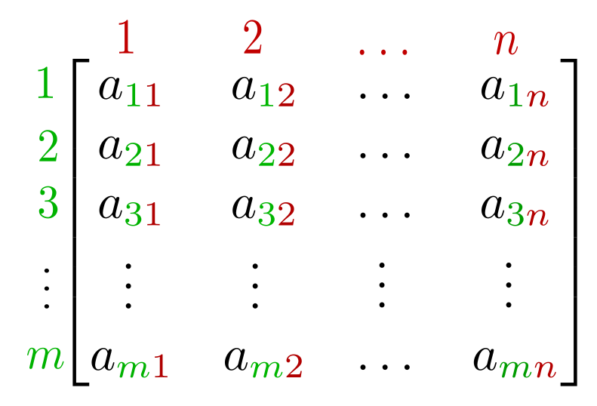
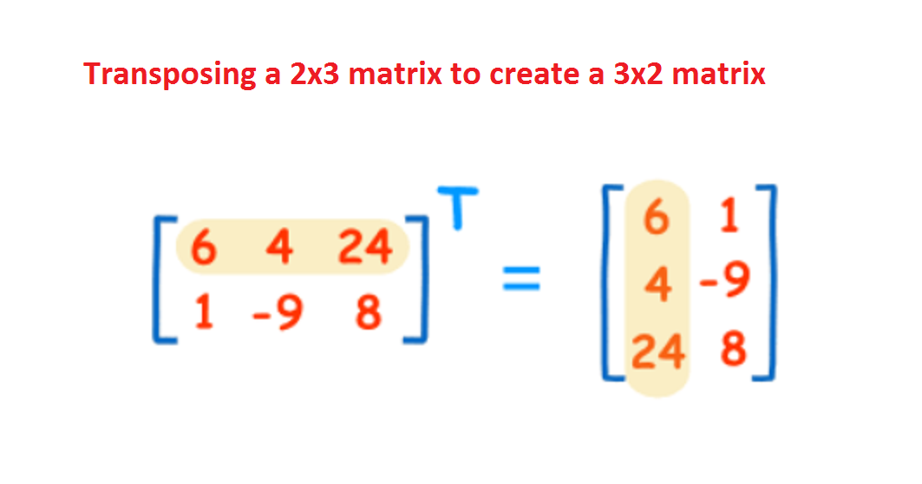
Linear Algebra 101

Slide 14
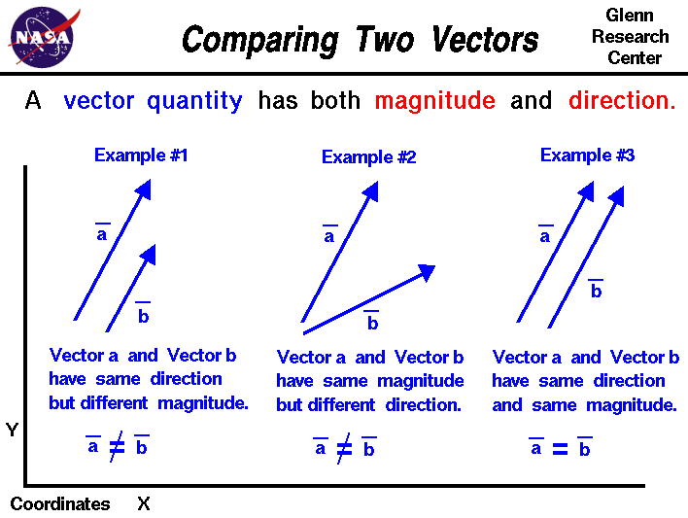
Linear Algebra 101

Slide 15
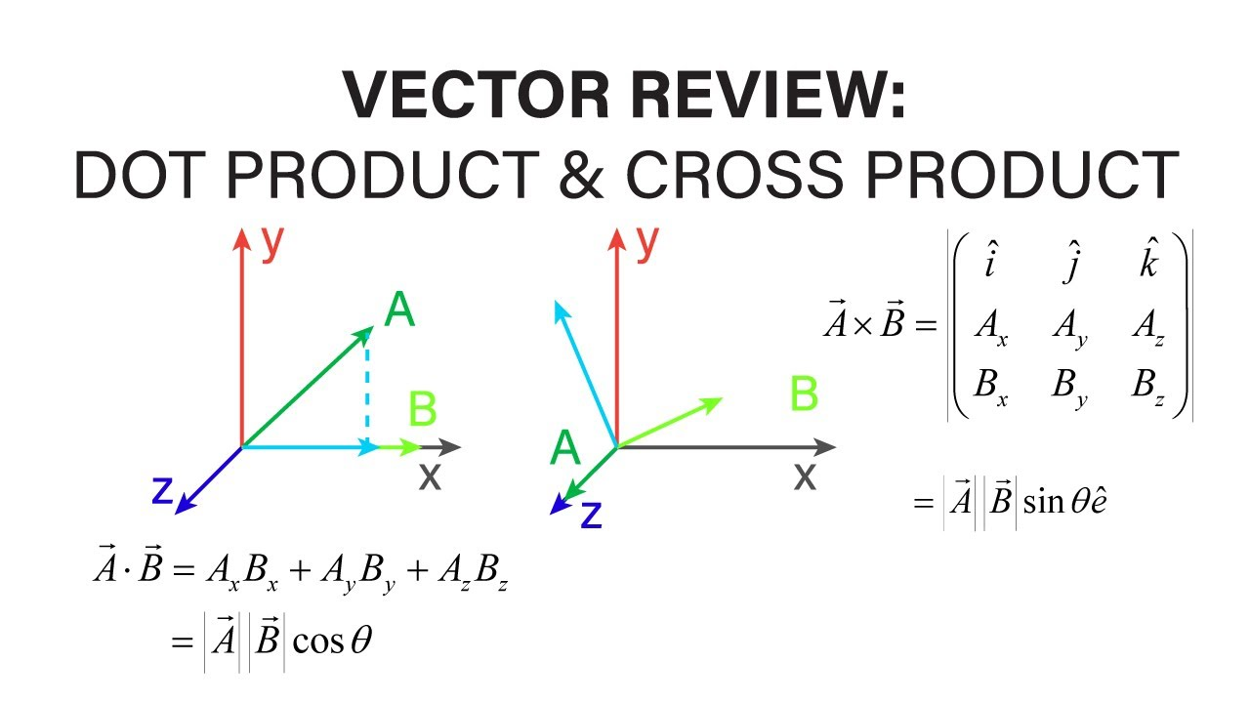
Linear Algebra 101

Slide 16
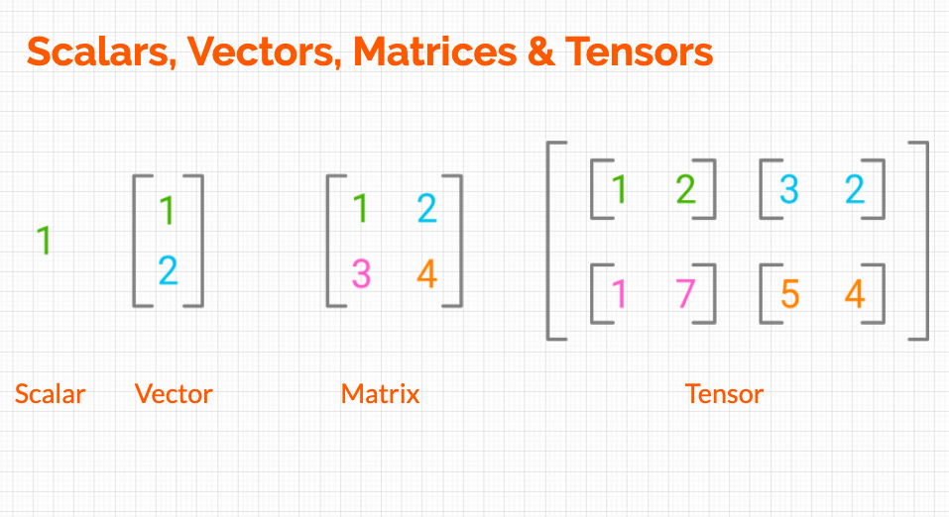
Linear Algebra 101

Slide 17
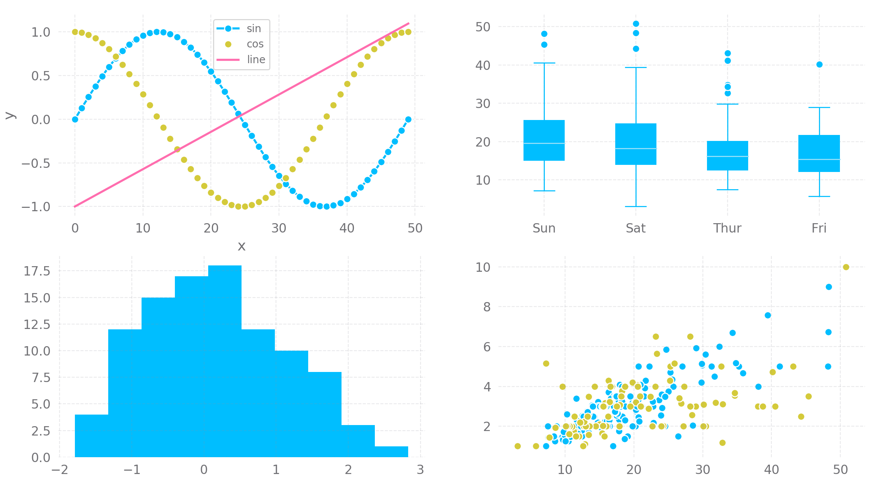
Graphs

Slide 18
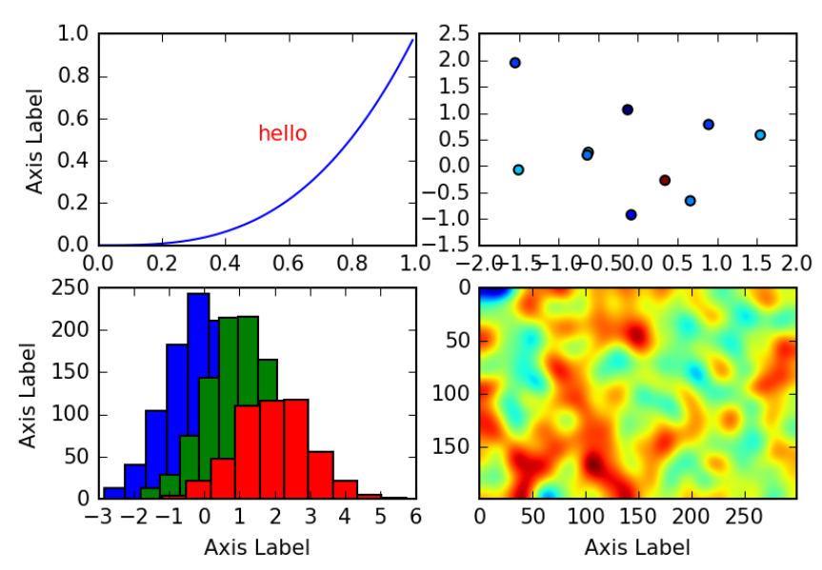
Graphs

Slide 19
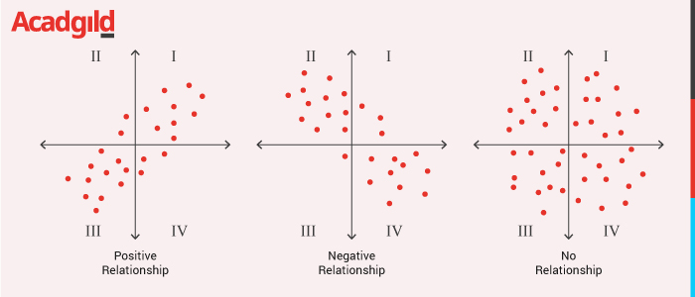
Graphs

Slide 20
Introduction to ML
Categorization of machine learning tasks arises when one considers the desired output of a machine-learned system:
Classification : When inputs are divided into two or more classes, and the learner must produce a model that assigns unseen inputs to one or more (multi-label classification) of these classes. This is typically tackled in a supervised way. Spam filtering is an example of classification, where the inputs are email (or other) messages and the classes are “spam” and “not spam”.
Regression : Which is also a supervised problem, A case when the outputs are continuous rather than discrete.
Clustering : When a set of inputs is to be divided into groups. Unlike in classification, the groups are not known beforehand, making this typically an unsupervised task.

Slide 21
Introduction to ML
Solution :
Two of the most widely adopted machine learning methods are supervised learning which trains algorithms based on example input and output data that is labeled by humans,
and unsupervised learning which provides the algorithm with no labeled data in order to allow it to find structure within its input data. Let’s explore these methods in more detail.

Slide 22
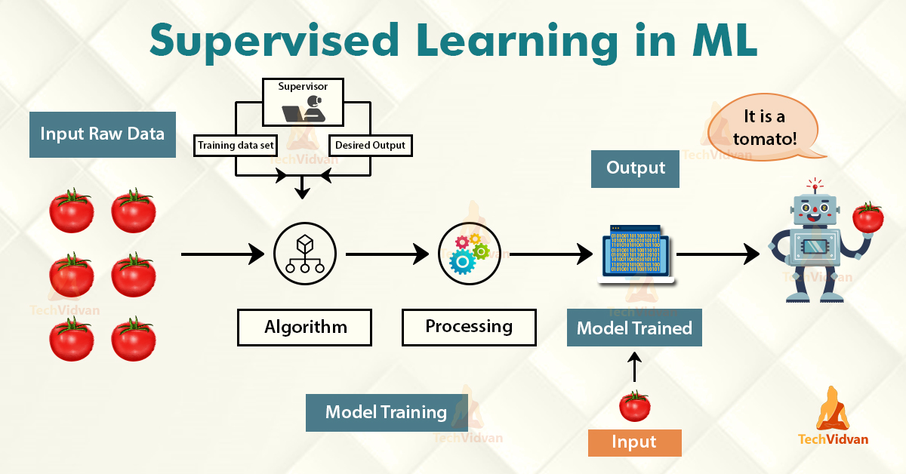
Supervised Algorithm

Slide 23
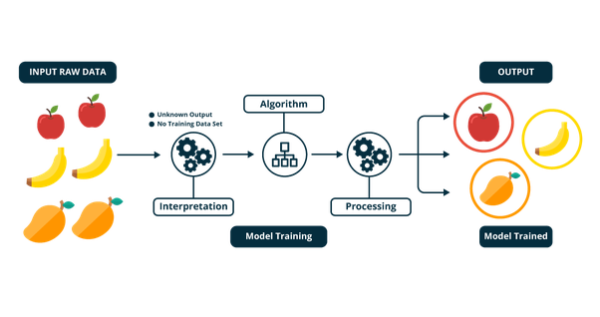
Unsupervised Algorithm

Slide 24
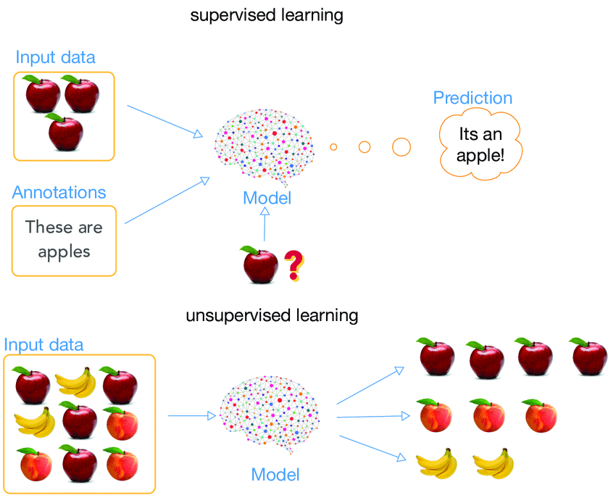
Comparison

Slide 25
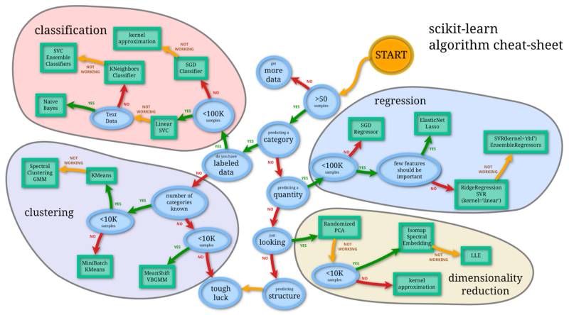
Roadmap Ahead

Slide 26
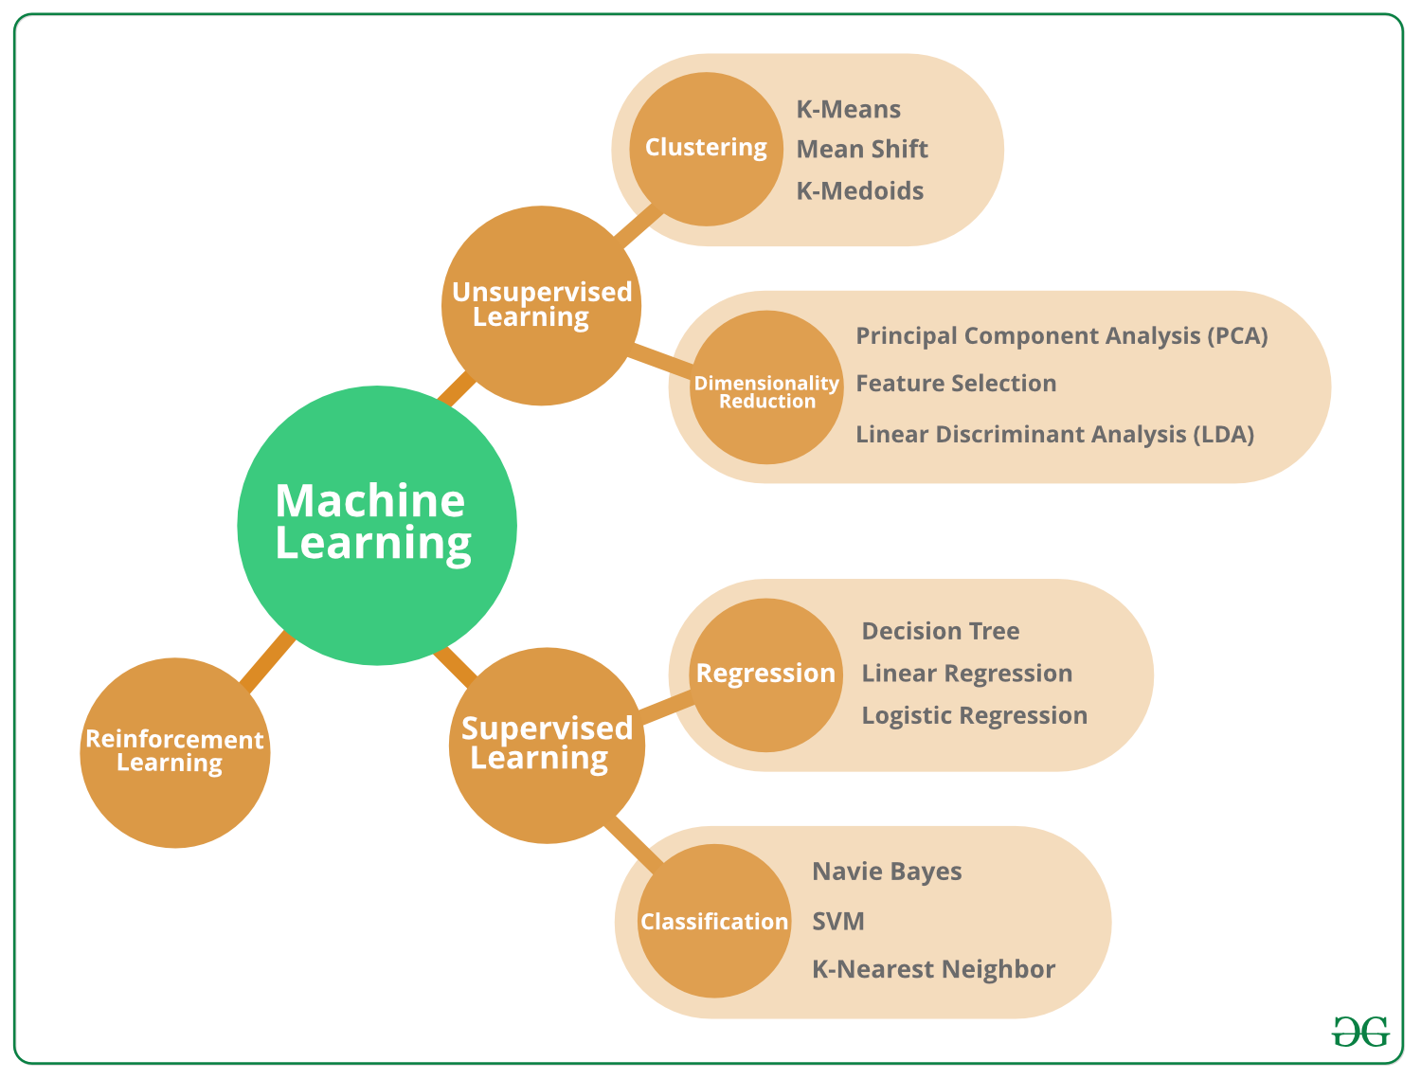
Roadmap Ahead

Slide 27
Day 2
Supervised algorithm

Slide 28
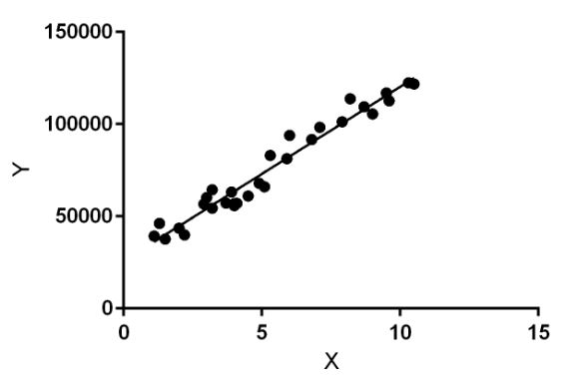
Linear Regression
Linear Regression is a machine learning algorithm based on supervised learning. It performs a regression task. Regression models a target prediction value based on independent variables. It is mostly used for finding out the relationship between variables and forecasting

Slide 29
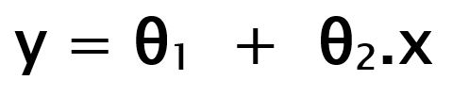
Linear Regression : Hypothesis
While training the model we are given : x: input training data (univariate – one input variable(parameter)) y: labels to data (supervised learning)
When training the model – it fits the best line to predict the value of y for a given value of x. The model gets the best regression fit line by finding the best θ₁ and θ₂ values. θ₁: intercept θ₂: coefficient of x

Slide 30
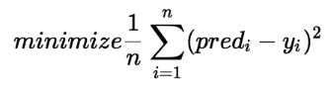
Linear Regression : Cost Function
Once we find the best θ₁ and θ₂ values, we get the best fit line. So when we are finally using our model for prediction, it will predict the value of y for the input value of x.
How to update θ₁ and θ₂ values to get the best fit line ?
Cost Function (J): By achieving the best-fit regression line, the model aims to predict y value such that the error difference between predicted value and true value is minimum. So, it is very important to update the θ₁ and θ₂ values, to reach the best value that minimize the error between predicted y value (pred) and true y value (y).

Slide 31
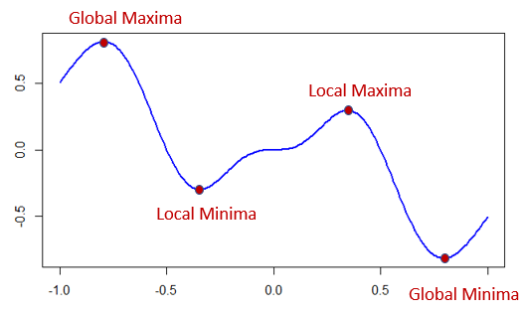
Linear Regression : Gradient Descent
To update θ₁ and θ₂ values in order to reduce Cost function (minimizing RMSE value) and achieving the best fit line the model uses Gradient Descent. The idea is to start with random θ₁ and θ₂ values and then iteratively updating the values, reaching minimum cost.

Slide 32
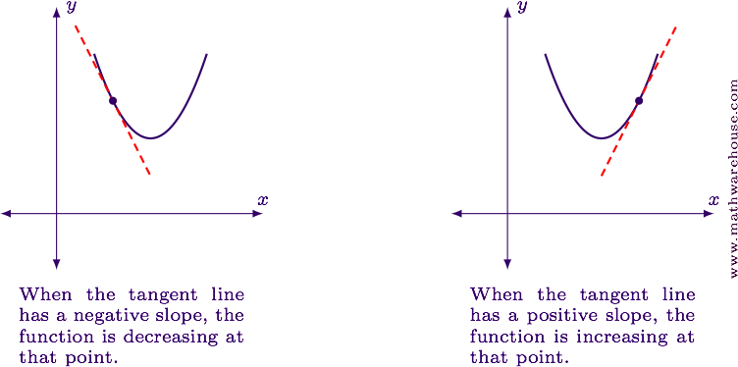
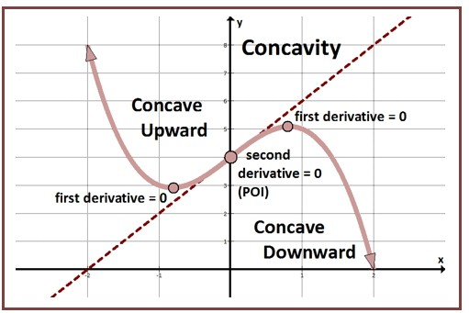
Linear Regression : Gradient Descent

Slide 33
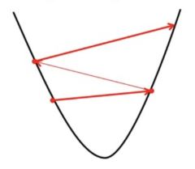
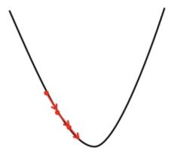
Linear Regression : Gradient Descent
Gradient Descent : Over shoot and Undershoot

Slide 34

Linear Regression : Gradient Descent

Slide 35

Multinomial way

Slide 36
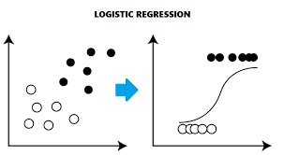
Logistic Regression
In statistics, the logistic model (or logit model) is used to model the probability of a certain class or event existing such as pass/fail, win/lose, alive/dead or healthy/sick. This can be extended to model several classes of events such as determining whether an image contains a cat, dog, lion, etc. Each object being detected in the image would be assigned a probability between 0 and 1, with a sum of one.

Slide 37
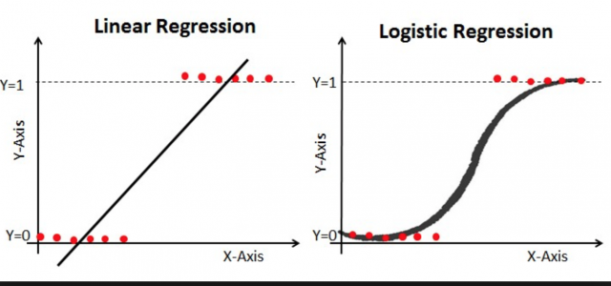
Logistic Regression vs Linear regression

Slide 38
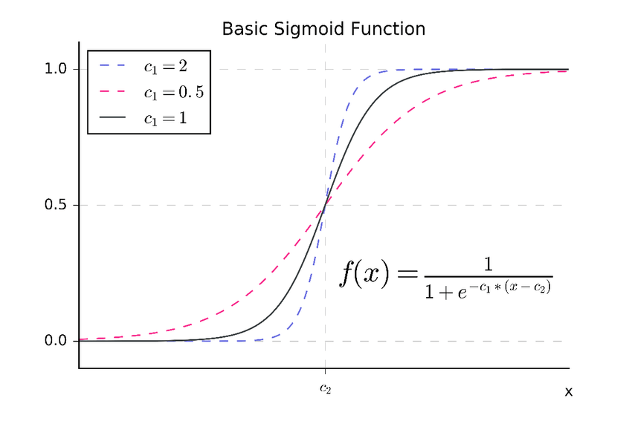
Logistic Regression : Sigmoid

Slide 39
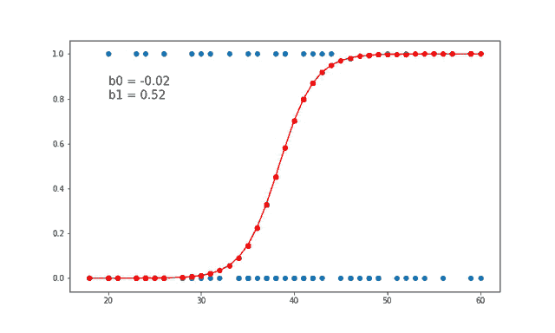

Logistic Regression : Sigmoid in action

Slide 40
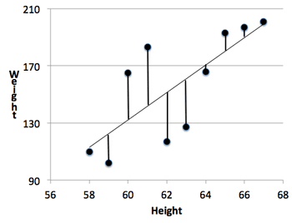
Regression Metrics: Are we any good

Slide 41
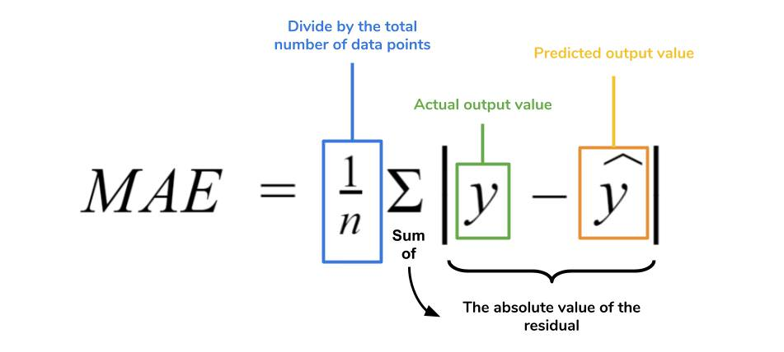
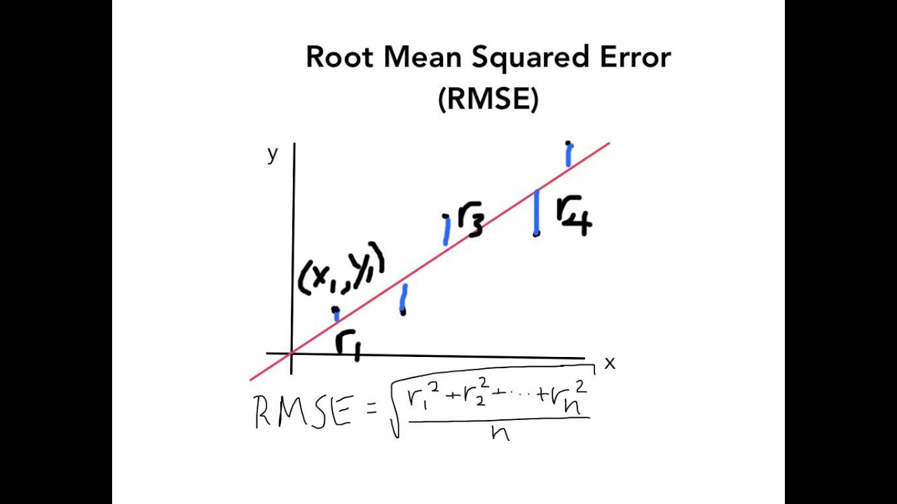
Regression Metrics: Are we any good

Slide 42
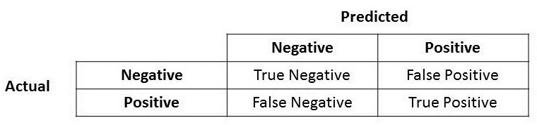
Classification Metrics: Are we any good
Confusion Matrix

Slide 43
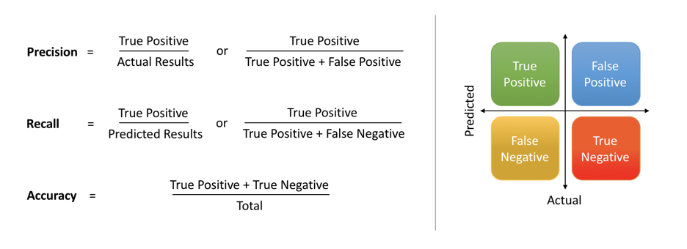
Classification Metrics: Are we any good

Slide 44
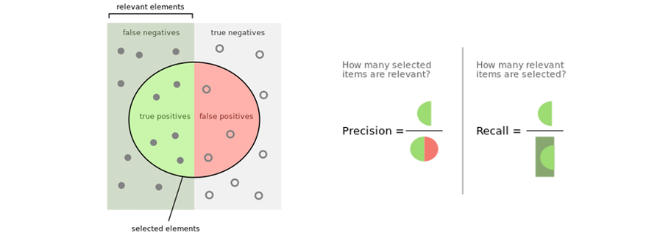
Classification Metrics: Are we any good

Slide 45
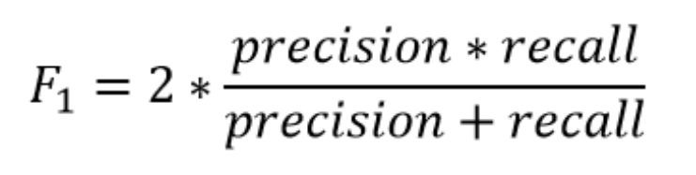
Classification Metrics: Are we any good

Slide 46
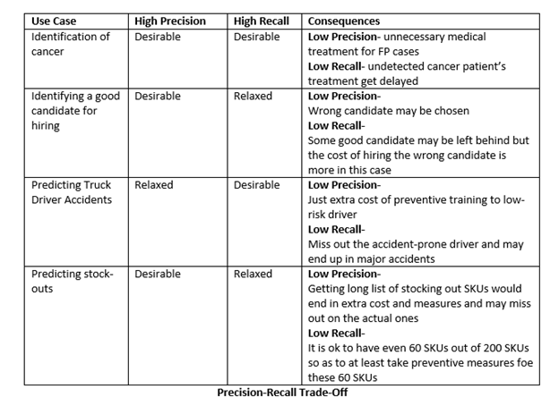
Classification Metrics: Are we any good

Slide 47
Day 3
Tree algorithm

Slide 48
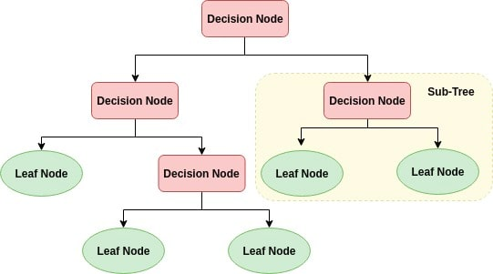
Tree Methods : Decision tree

Slide 49
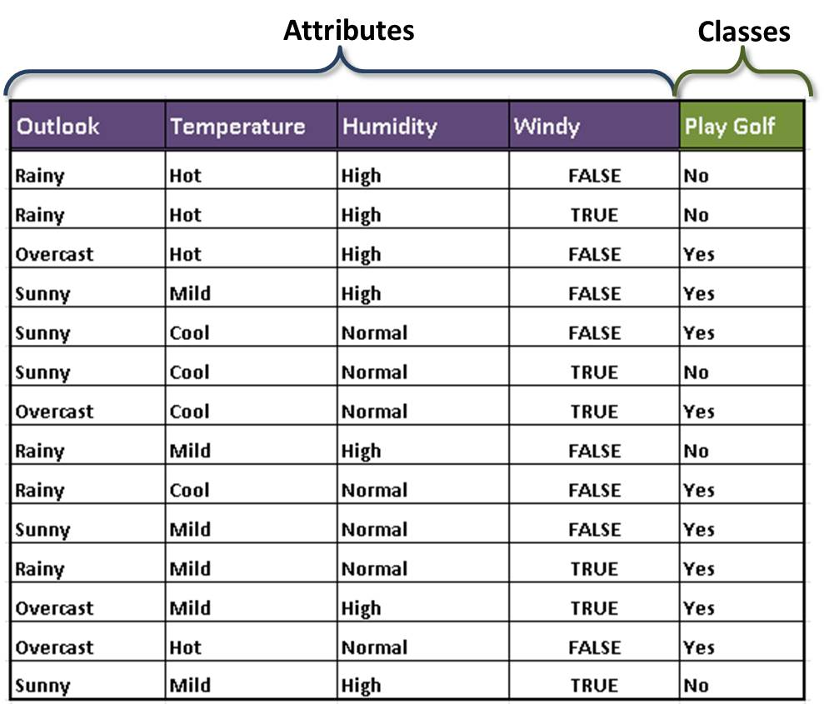
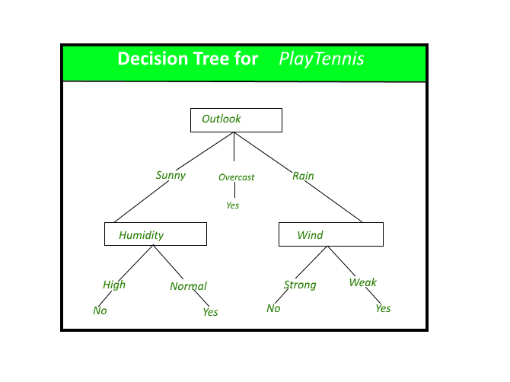
Tree Methods : Decision tree

Slide 50
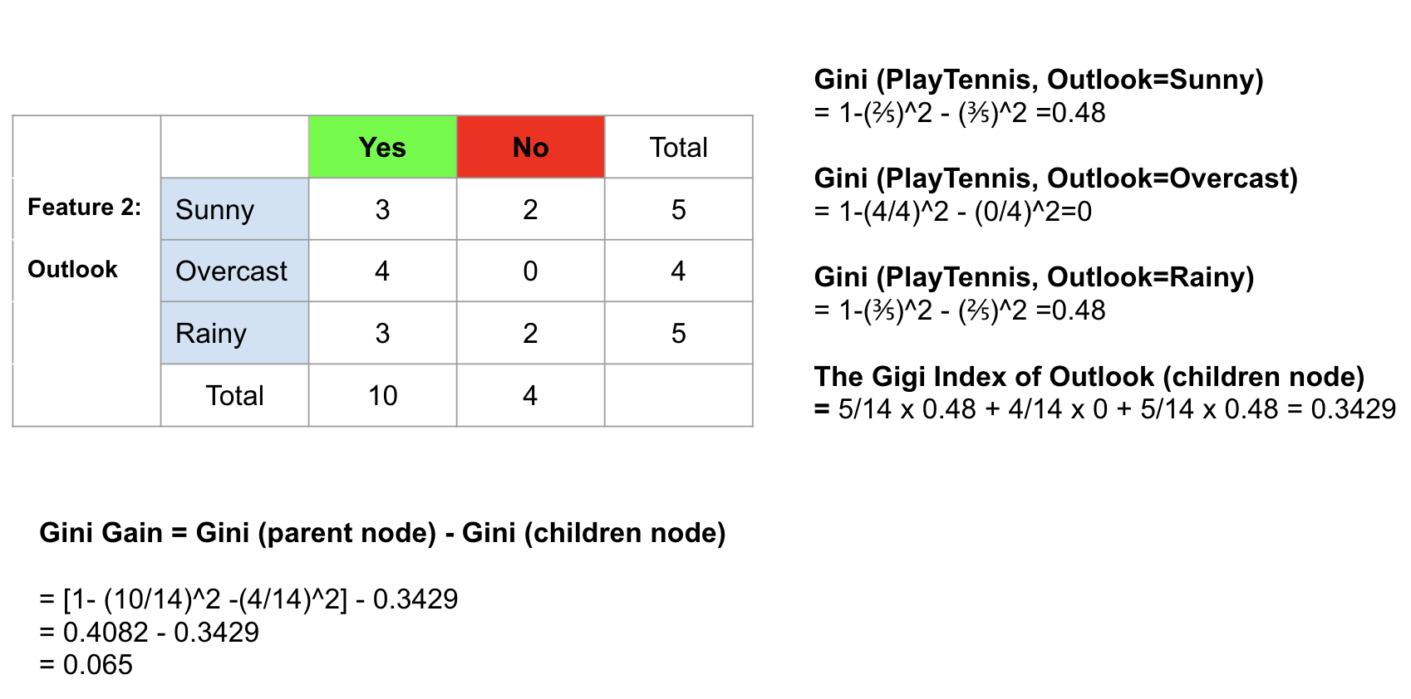
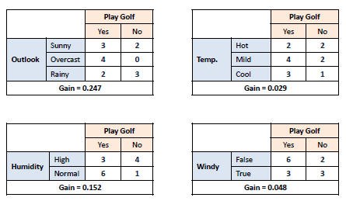
Tree Methods : Decision tree

Slide 51
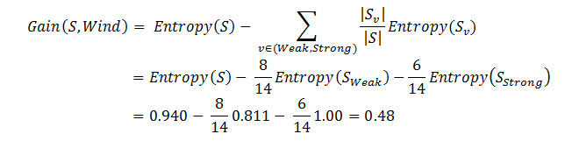
Tree Methods : Decision tree

Slide 52
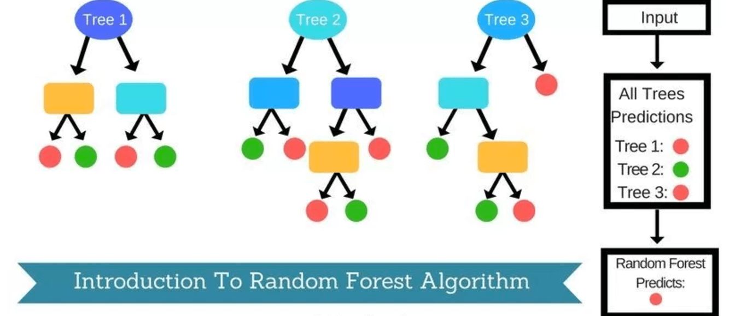
Tree Methods : Random Forest

Slide 53
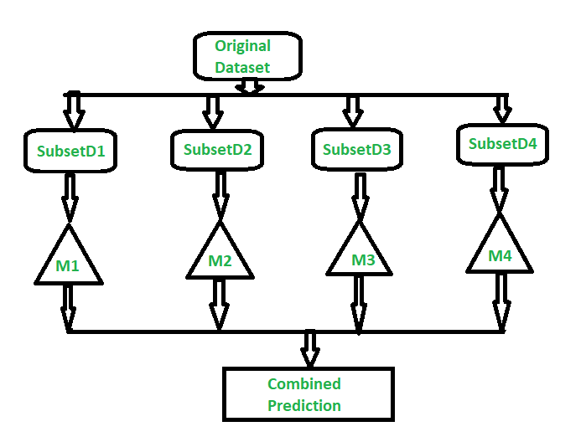
Tree Methods : Random Forest Ensemble

Slide 54
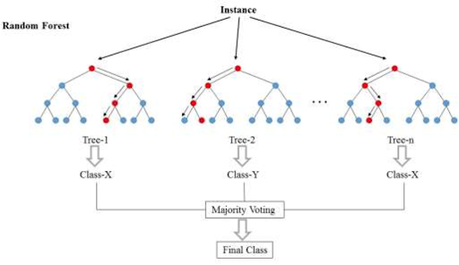
Tree Methods : Random Forest Voting

Slide 55

Tree Methods : Random Forest Averaging

Slide 56


Tree Methods : Random Forest Churn/Ada Boost

Slide 57
Day 4
SVM and KNN

Slide 58

KNN : K Nearest Neighbor

Slide 59


KNN

Slide 60

How to Choose K

Slide 61

SVM : Support Vector Machine

Slide 62


SVM : Support Vector Machine

Slide 63

SVM : Support Vector Machine

Slide 64

SVM : Support Vector Machine

Slide 65

SVM : Support Vector Machine

Slide 66

SVM : Support Vector Machine

Slide 67

SVM : Support Vector Machine : Kernel

Slide 68

SVM : Support Vector Machine :Kernel

Slide 69

SVM : Support Vector Machine :Kernel

Slide 70

SVM : Support Vector Machine :Grid Search

Slide 71
Day 5
Unsupervised : K- Means

Slide 72
K- Means
The algorithm will categorize the items into k groups of similarity. To calculate that similarity, we will use the Euclidean distance as measurement.
The algorithm works as follows:
First we initialize k points, called means, randomly.
We categorize each item to its closest mean and we update the mean’s coordinates, which are the averages of the items categorized in that mean so far.
We repeat the process for a given number of iterations and at the end, we have our clusters.
The “points” mentioned above are called means, because they hold the mean values of the items categorized in it.

Slide 73

K- Means : Iteration

Slide 74

K- Means : How to choose K

Slide 75
Reading
NLP
Recommender system
Deep Learning

